Slide 1



HOME CREDIT DEFAULT RISK
GROUP 4
PAVANI PRAGADA
SAI ANOGNA CHITTUDI
SUSHMA SREE MUTYAPU

Slide 2
AGENDA
Business
Problem
Data
Overview
Objective
01
02
03
Model
Building
Best
Model
Business Insights
04
05
06

Slide 3

BUSINESS PROBLEM STATEMENT
Loan services to people with little or no credit history.
Maximize the Loan approval process.
Identify customers with high repayment ability.
Predicting customers with high-risk.
Finding Predictive model to address the financial service gap.

Slide 4
PROJECT OBJECTIVE
Creating a Classification Predictive model to predict the customers risk to default.
Expanding loan approvals to a broad customer base with strong repayment capabilities.

Slide 5

DATA OVERVIEW
Five Different datasets are available:
Application data(Train and Test)
Bureau Data
Bureau Balance
Previous Application Data
Credit Card Balance

Slide 6

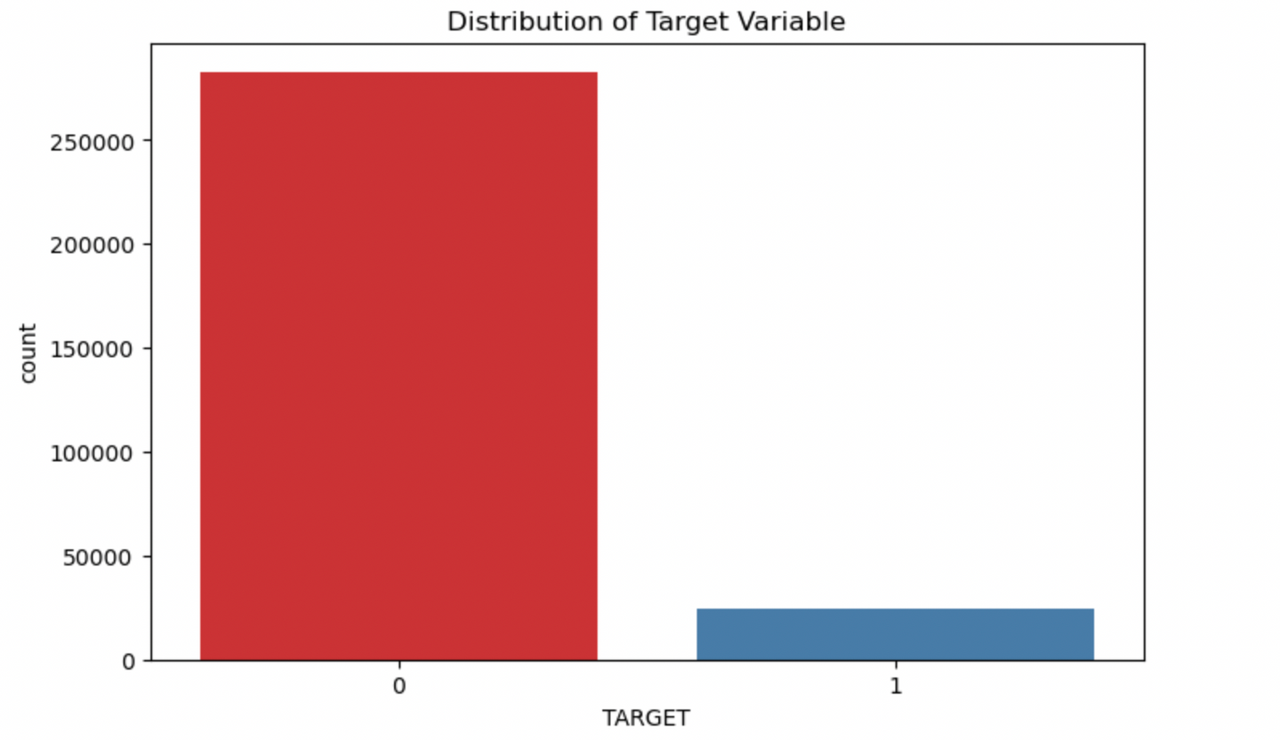
TARGET VARIABLE DISTRIBUTION
The Target variable is imbalanced, with Class 0 having 282,686 samples and
Class 1 having only 24,825 samples

Slide 7
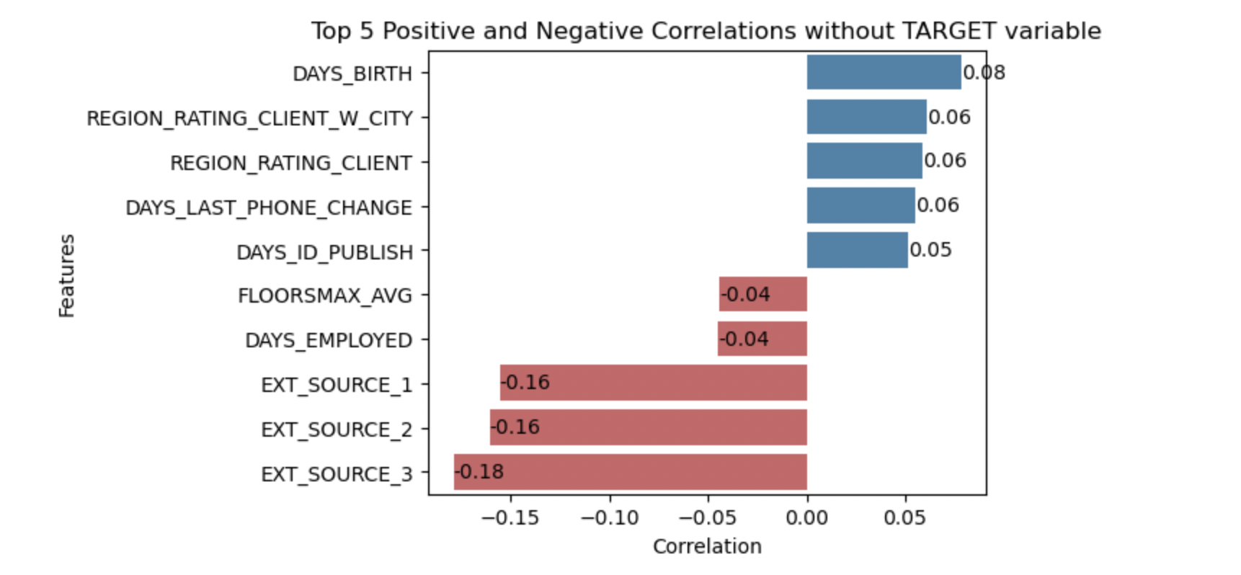
DATA PREPARATION
Correlations

Slide 8




DATA PREPARATION
Mistaken values : Absolute function is used to handle mistaken values.
50%
Columns with missing values more than 50% are removed.
Categorical columns: Imputing missing values with the most frequent value mode.
Numerical columns: Imputing missing values with median value.

Slide 9


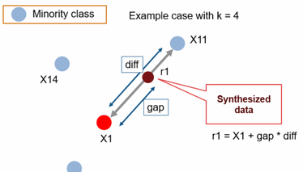
DATA PREPARATION
Label Encoding: Columns that had only two unique categories.
One hot Encoding: Columns with more than two categories.
Outliers Handling: Winsorization
90% winsorization - For all observations >95th percentile is set to 95th percentile
For all observations < 5th percentile is set to 5th percentile
SMOTE Sampling - Creates synthetic examples for the minority class by interpolating between existing minority class and their nearest neighbors.

Slide 10

FEATURE ENGINEERING
Ratios:
Debt-To-Income Ratio(DIR)
Annuity-To-Income Ratio(AIR)
Annuity-To-Credit Ratio(ACR)
Days-Employed-To-Age Ratio(DAR)
Bureau table data added for better predictions
Added New variables - Ratios calculated from original data
Notes:
We moved to next phase that is feature engineering.
Bureau data is added to our application train data, this will add more features to the model, and helps in predicting whether the applicant is capable of loan repayment in an accurate way.
We have added 4 new variables,
evaluating not just credit history, but also we need to take care of capacity, capability, and collateral status of applicant will give broader view.
For example, to evaluate the capacity of applicant, debt- to income ratio is added- amount of debt/ income before taxes.
Likewise, other three variables are added.

Slide 11

MODEL BUILDING
Logistic Regression
XG Boost
Random Forest Classifier
Light Gradient Boosting Machine

Slide 12

MODEL DEPLOYMENT
01
Application Train data is split in 75/25 ratio
Train/Test split
02
Cross Validation
K fold Cross validation to reduce model overfitting
03
Hyper Parameter Tuning
To find Optimum Hyper parameters
04
Performance Metrics
Evaluate performance metrics to find best model

Slide 13

PERFORMANCE METRICS
Model Name | Accuracy | AUC Score | Run Time
Logistic Regression | 0.92 | 0.63 | 2.5 sec
XG Boost | 0.91 | 0.71 | 1000s
Random Forest Classifier | 0.88 | 0.68 | 3844.5s
Light Gradient Boosting | 0.92 | 0.76 | 700s
Top Performers - XG Boost and Light Gradient Boost

Slide 14
BEST MODEL
Light Gradient Boosting Machine
Pros:
High Accuracy - 92%
ROC-AUC Score - 0.76
Tuned Hyperparameter set
No Data preprocessing required for this Model(Multicollinearity, Outliers)
Cons:
Moderate Run Time

Slide 15
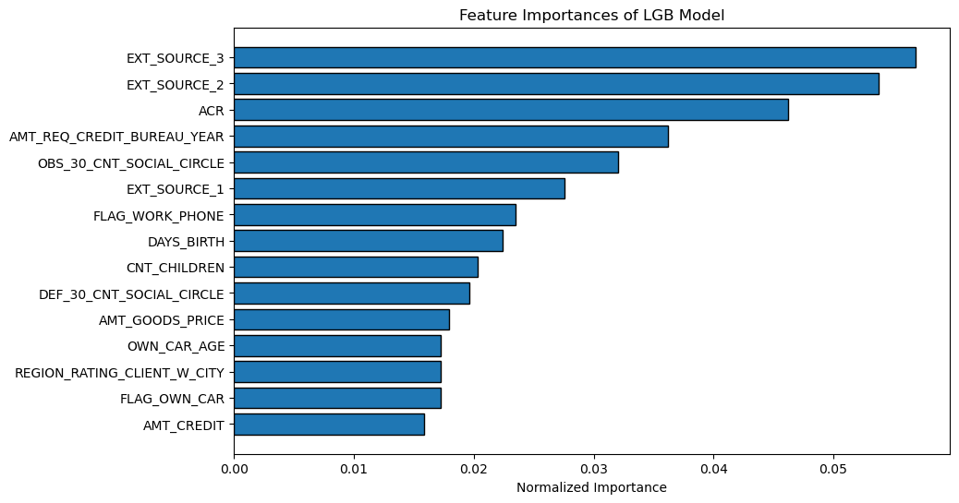
TOP PREDICTORS

Slide 16

RESULTS
Sample: 10,000 customers less likely to default
Models | Precision value | Correct Predictions | Wrong Predictions
Best Model - Light Gradient Boosting(LGB) | 0.92 | 9984 | 16
Base Model - Logistic Regression | 0.69 | 6807 | 3193
Aligns with our goal to maximize identification of customers with repayment ability increasing the revenue.

Slide 17


BUSINESS INSIGHTS
Key Factors: External data scores and ACR (Annuity-to-credit ratio) crucial for identifying low-risk customers.
Highly Reliable Customer Traits: Married individuals, car and house owners, and those with higher education exhibit lower default likelihood across all models.

Slide 18
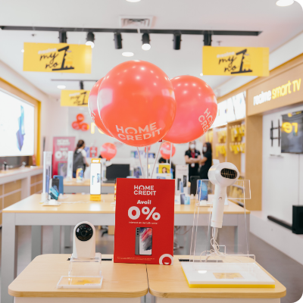
THANK YOU
QUESTIONS?

